Slide 1
Making Human-Like Moral Decisions
Andrea Loreggia, University of Brescia
Nicholas Mattei, Tulane University
Taher Rahgooy, University of West Florida
Francesca Rossi, IBM Research
Biplav Srivastava, University of South Caroliana
Kristen Brent Venable, IHMC and University of West Florida

Slide 2

Overview
Humans make difficult trade-offs: do we always follow all the traffic rules or do we violate the speed limit in an emergency? How should we balance ethical values, safety recommendations, and societal norms?
For effective AI-human collaboration, we must equip AI agents with a model of how humans make such trade-offs in environments where there is not only a goal to be reached, but there are also ethical constraints
We leverage a cognitive model of human decision making, called multi-alternative decision field theory (MDFT) to orchestrate competing policies.
We show our method is more general then taking simple averages and performs better in terms of mimicking human decisions as collected through Amazon Mechanical Turk (AMT).

Slide 3
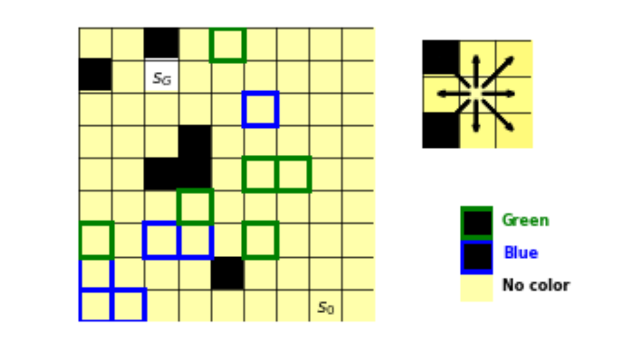
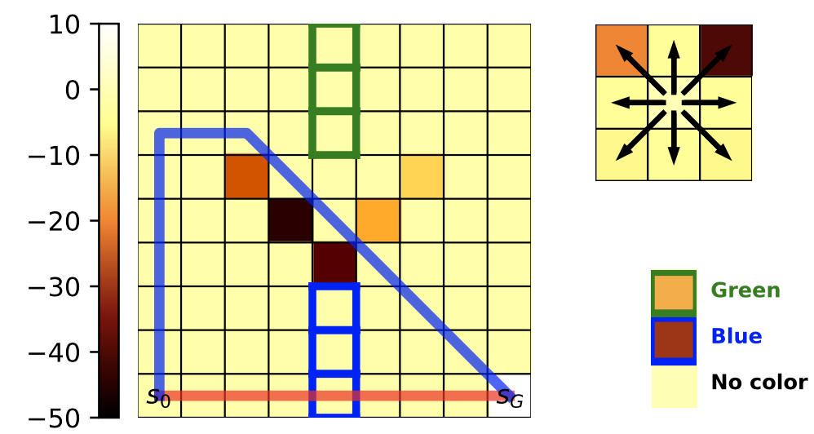
Overall Goal
All our results are set in an MDP:
S is a finite set of discrete states and A_{𝑠} ⊆ A is a set of actions
𝑃 : S × A × S → [0, 1] is a model of the environment
given as transition probabilities: 𝑃 (𝑠𝑡 +1 |𝑠𝑡 , 𝑎𝑡 ).
𝐷₀ : S → [0, 1] is a distribution over start states;
𝜙 : S × A × S → R_{𝑘} is a map from transitions to a 𝑘-dimensional space of features;
𝛾 ∈ [0, 1) is a discount factor; and
𝑅 : S × A × S → R is a scalar reward received by the agent.
A Constrained MDP M^{C} is a nominal MDP M^{N} with an additional cost function C : S ×A ×S → R and a budget 𝛼 ≥ 0.
The cost of a trajectory to be 𝑐 (𝜏) = E (𝑠𝑖 , 𝑎𝑖 , 𝑠𝑖+1)
𝛼 = 0 is hard constraints
See our Paper on how to learn these from demonstrations: Arie Glazier, Andrea Loreggia, Nicholas Mattei, Taher Rahgooy, Francesca Rossi, Kristen Brent Venable: Learning Behavioral Soft Constraints from Demonstrations. CoRR abs/2202.10407 (2022)

Slide 4
Problem Setting
Given this we have 3 types of Constraints:
Action Constraints: An agent should not perform some (set of) action 𝑎_{𝑖};
Occupancy Constraints: An agent should not occupy a (set of) states 𝑠_{𝑖};
Feature Constraints: Given a feature mapping of transitions 𝜙, an agent should not perform an (set of) action in presence of specific state features.
The optimal policies for M^{N} and M^{C} , denoted with 𝜋^{𝑛} and 𝜋^{𝑐}
Key Question: How do we combine these policies in ways that are human like and/or ethical?
Do we always follow all the constraints, or do we focus on environment rewards?

Slide 5
How Does this Map to Ethics?
Action Constraints: An agent should not perform some (set of) action 𝑎_{𝑖};
Occupancy Constraints: An agent should not
occupy a (set of) states 𝑠_{𝑖};
Feature Constraints: Given a feature mapping of transitions 𝜙, an agent should not perform an (set of) action in presence of specific state features.
These constraints are general and inspired by two ethical stances:
“Deontological-style Constraints.” Deontology evaluates actions based on their rightness or wrongness, as well as the intention of the agent. We can roughly approximate a simplified version of it by classifying certain actions as wrong and others as right.
“Consequentialist-style (utilitarian) Constraints.” Consequentialism evaluates the merits of an action by outcomes and thus focus on the state where an action will take us. They try to avoid or penalize ending up in “bad” states, no matter what actions are adopted
We consider constraints (whose violation generates a penalty) on both actions and states, thus modelling both of these stances: in this grid, moving up left and down left is “bad”, green and blue states are “bad”, and each of the black cells are “bad” states.

Slide 6
Problem Setting
Given this we have 3 types of Constraints:
Action Constraints: An agent should not perform some (set of) action 𝑎_{𝑖};
Occupancy Constraints: An agent should not occupy a (set of) states 𝑠_{𝑖};
Feature Constraints: Given a feature mapping of transitions 𝜙, an agent should not perform an (set of) action in presence of specific state features.
The optimal policies for M^{N} and M^{C} , denoted with 𝜋^{𝑛} and 𝜋^{𝑐}
Key Question: How do we combine these policies in ways that are human like and/or ethical?
Do we always follow all the constraints, or do we focus on environment rewards?

Slide 7

General Model
Given access to both 𝜋^{𝑛} and 𝜋^{c} we can define vector ⟨𝑠𝑞_{𝑛}(𝑠, 𝑎)⟩ that gives us the probability of action selection in 𝜋.
We propose three models for combining these policies:
Greedy Orchestrator G-O: uses policy 𝜋^{𝐺} , where 𝜋^{𝐺}(𝑠) = 𝑎, selects an action 𝑎 with overall highest value.
Weighted Average Orchestrator WA-O: uses policy 𝜋^{𝑊} where, given weight vector (𝑤𝑛, 𝑤𝑐 ) with 𝑤𝑛 ,𝑤𝑐 ∈ [0, 1] and 𝑤𝑐 + 𝑤𝑛 = 1, action 𝑎 = 𝜋𝑊 𝐴 (𝑠) is chosen according to prob ability distribution 𝑝𝑊 𝐴 (𝑎𝑖 ) = 𝑤𝑛𝑠𝑞𝑛 (𝑠, 𝑎𝑖 ) + 𝑤𝑐𝑠𝑞𝑐 (𝑠, 𝑎𝑖 ).
MDFT Orchestrator MDFT-O: chooses actions according to policy 𝜋^{𝑀𝐷𝐹𝑇} . Action 𝑎 = 𝜋^{𝑀𝐷𝐹𝑇} (𝑠) is chosen via an MDFT model.
We prove that MDFT-O is a strict generalization of the others!
MDFT-O can capture both G-O and WA-O as well as additional policies including non-linear mixes!

Slide 8
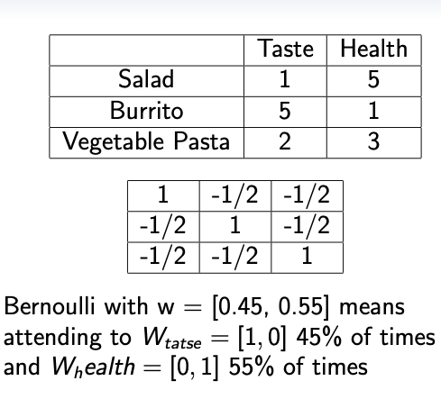
Multi-Alternative Decision Field Theory (MDFT)
MDFT is a cognitive process model of how humans deliberate (not normative).
Information is sequentially sampled/accumulated over time till a decision.
Able to capture violations of rationality.
Given options A and B: A has better performance but poorer efficiency with respect to B.
Similarity: Adding C similar to A will decrease selection of A.
Compromise: Adding C between A and B will decrease selection of A and B.
A MDFT model is comprised of:
Personal Evaluations (M)
Contrast Matrix (C)
Attention Weights (w)
Notes:
Given two options A and B: assume that A has better performance but poorer efficiency with respect to B.
Similarity: introducing a third option C, similar to A, will decrease A’s probability of being chosen and will increase B’s probability of being selected.
Compromise:

Slide 9
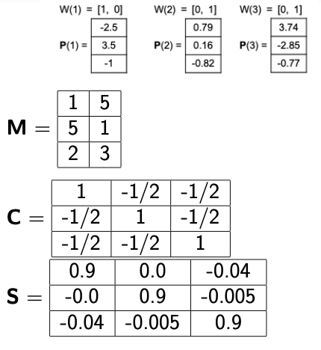
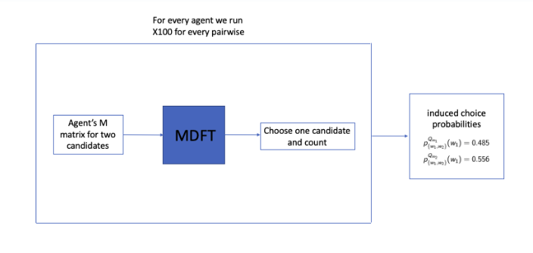
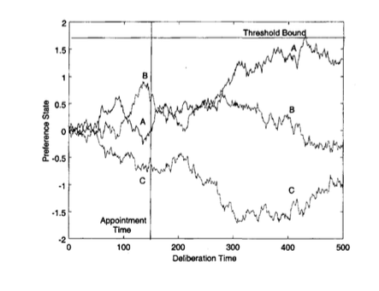
MDFT Preference Accumulation
Update the preferences by:
P(t+1)= S × P(t) + V(t+1)
V(t) = C × M × W(t)
Feedback Matrix: S computed from a similarity model of M in a standard way (Hotaling).
Notes:
Feedback Matrix: S computed for our running example following the MDFT standard method described in Hotaling et al. [19].

Slide 10
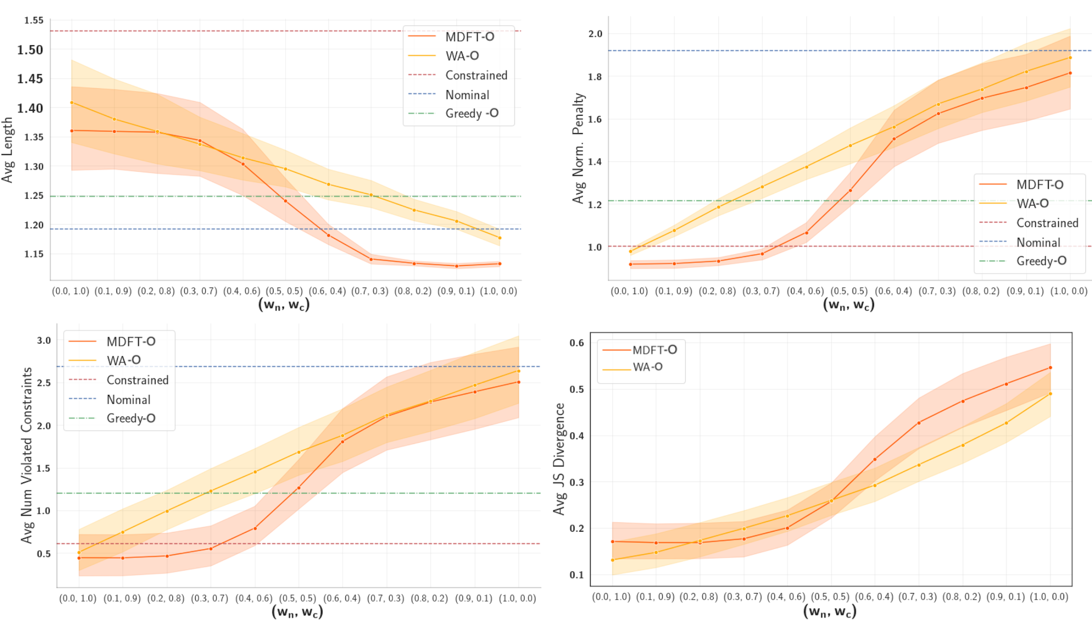
Computational Experiments
Computationally we see:
As we mix the two policies and their importance MDFT-O is able to maintain high levels of reward and produce reliably short paths.

Slide 11
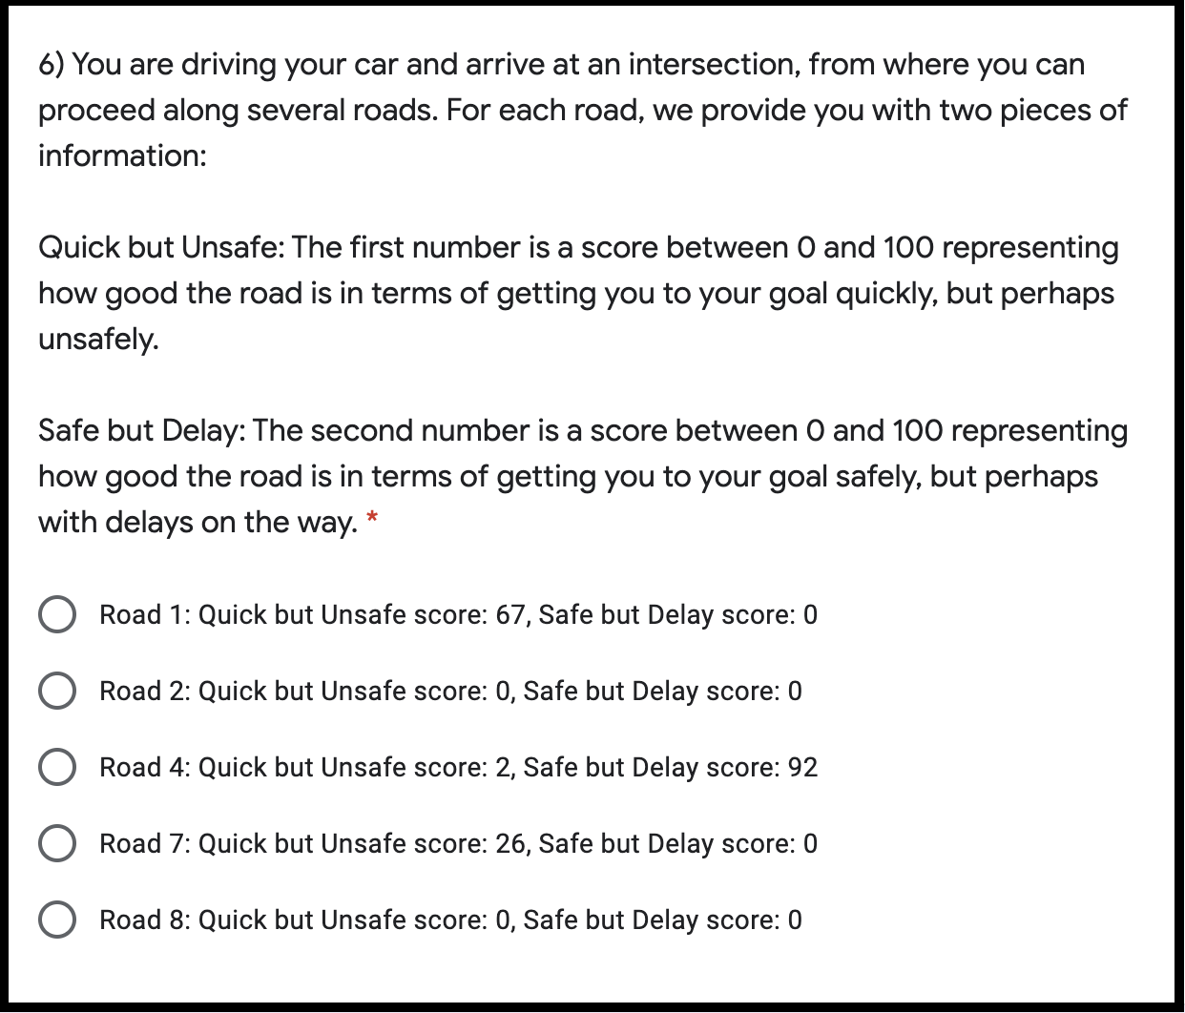
Survey Context - Human Experiments
Survey Design
Framed in terms of choosing different roads at an intersection where each road is labeled with two values:
the first one representing how fast (but possibly unsafely) it will take the respondent to destination and
the second representing how safe, but possibly slower, the road is.
The roads were used as proxies of the actions on the grid
Scores presented to the participants were obtained by multiplying the corresponding 𝑠𝑞𝑛 and 𝑠𝑞𝑐 values by 100.
IRB Exemption and Compensation: This research study has been certified as exempt
from the IRB per 45 CFR 46.104(d)(3) and 45 CFR 46.111(a)(7) by University of South Carolina IRB# Pro00118795. Participants were compensated at a rate of 1 USD per survey attempt consisting of 9 questions and the validation check. Amazon charged an additional administrative fee of 40%.

Slide 12
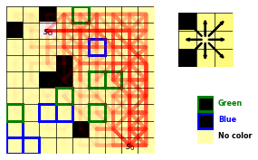
Data: Human Trajectories
9x9 grid made 81 questions with a question having a maximum of 8 solution choices
(questions regarding boundary cells had fewer).
The questions were divided into 9 sub-surveys consisting of 9 questions and a validation question (requiring the sub-survey number to be entered).
The participants were given a common survey link and a participant could be assigned any of the 9 sub-surveys 2.
A total of 185 participants responded and we obtained an average of 21 responses per cell.
We then used the frequencies with which participants chose the different roads to obtain a probability distribution over the actions of the corresponding cell.
We generated trajectories by starting from the initial state and repeatedly sampled actions according to the obtained distributions until we reached the goal. These trajectories as human trajectories.

Slide 13
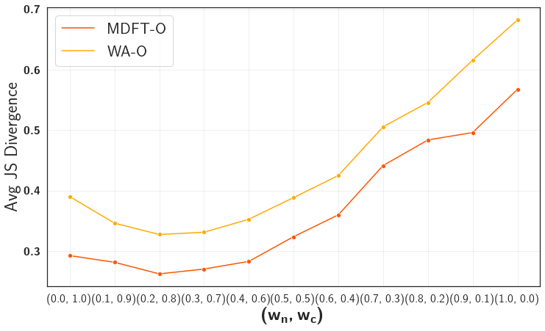
Result: Human Experiment
Average JS divergence between 200 trajectories generated by using respectively WA-O and MDFT-O with different settings of the attention weights and 200 human trajectories
MDFT-O outperforms WA-O for every combination of weights
Confirms its superiority in capturing human decision making even in this complex setting with multiple options
MDFT-O trajectories generated are closest to the human ones when attention weights are set to 0.2 for the nominal world and 0.8 for the constrained world (minimal obtained JS-divergence is 0.262337). This suggests that, on average, participants cared substantially more about safe driving than reaching the destination at all costs.

Slide 14
Conclusions
For effective AI-human collaboration, we must equip AI agents with a model of how humans make such trade-offs in environments where there is not only a goal to be reached, but there are also ethical constraints
We leverage a cognitive model of human decision making, called multi-alternative decision field theory (MDFT) to orchestrate competing policies.
We show our method is more general then taking simple averages and performs better in terms of mimicking human decisions as collected through Amazon Mechanical Turk (AMT).

